Slide 1

Presentation Deck
By WokeRUs

Slide 2
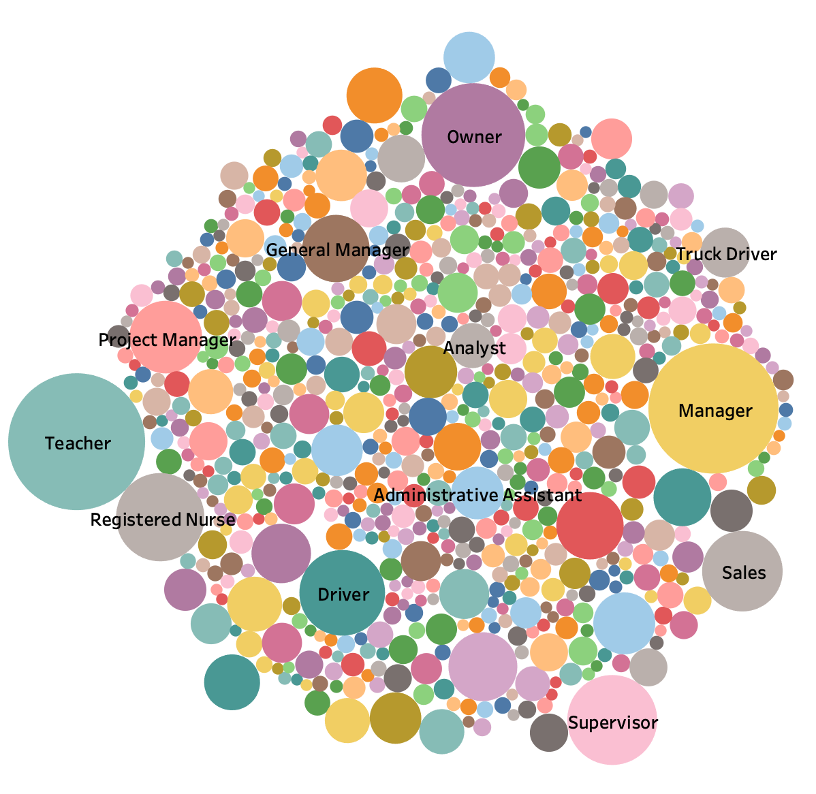
Why do people need loans?
This chart depicts the top 1000 job titles in the accepted data set where the bigger the circle, the more times it was listed in the dataset.

Slide 3
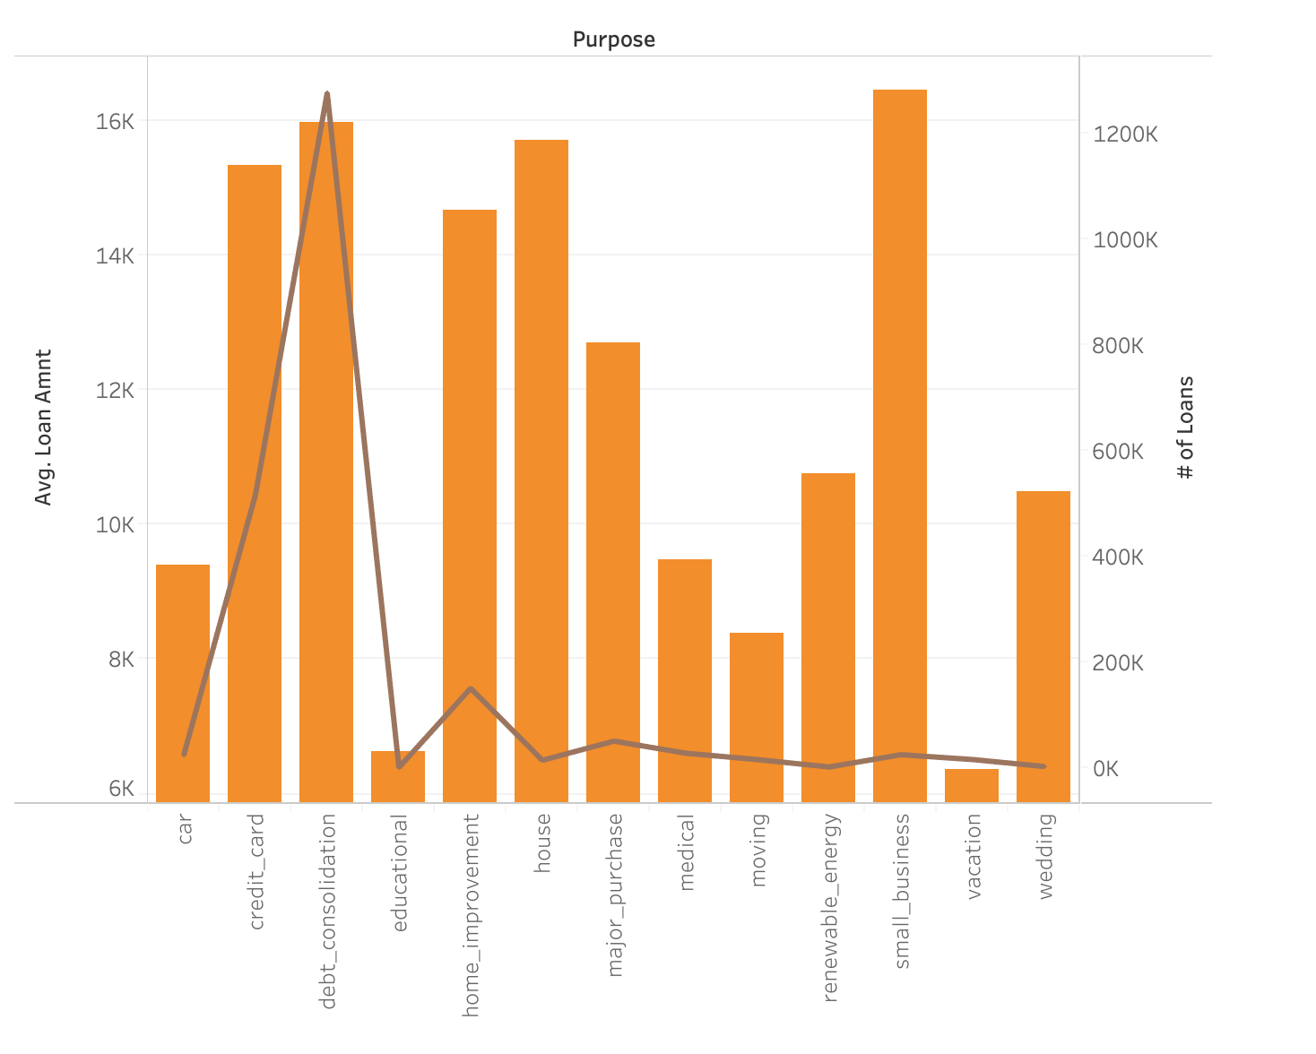
Purpose of Loans
Based upon the purpose of the loan
the avg of loan amount (the brown line)
The # of loans (the orange bar)
Here, we can see that most loans are taken out for debt consolidation which is also one of the top reasons for the loan (which is pretty telling).

Slide 4
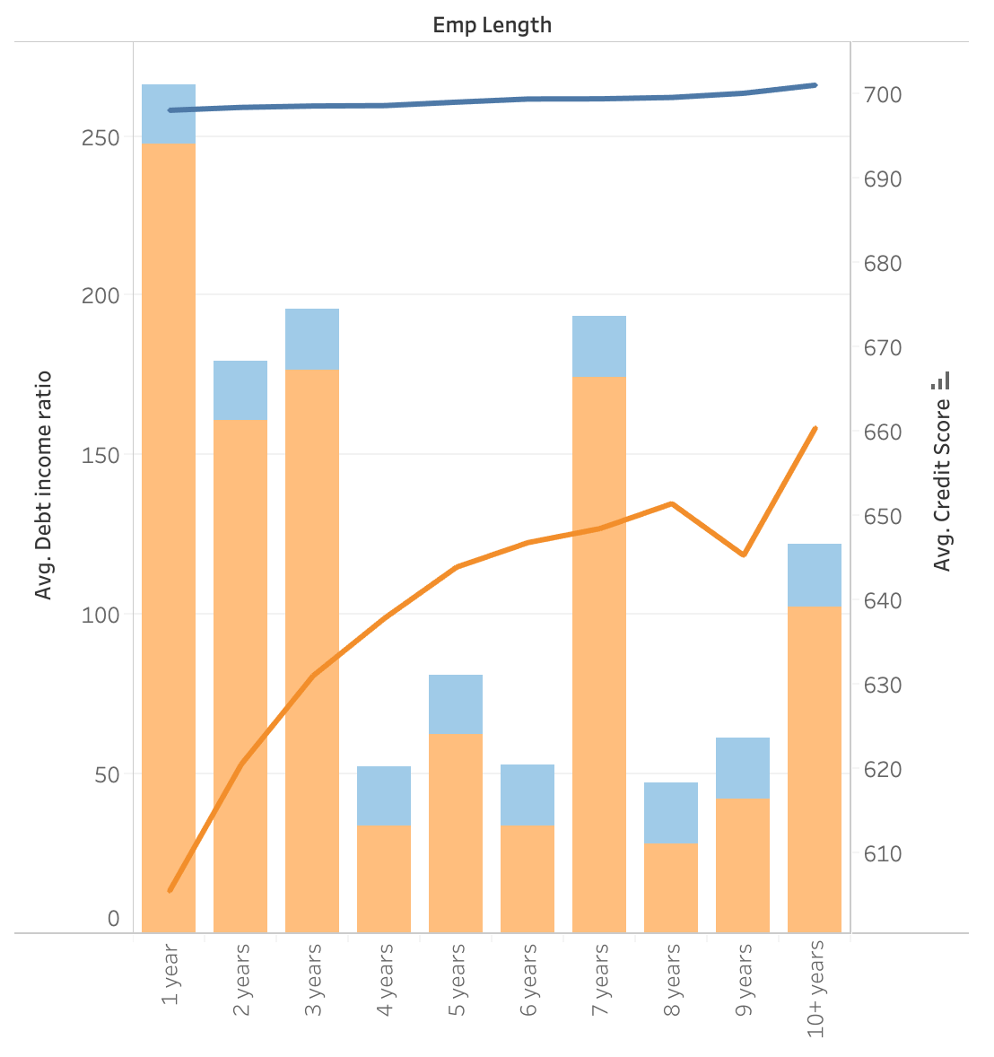
Candidates for a successful loan
Based on the employee length
Avg DTI (bars)
Avg Cred score (line)
accepted(Blue)/rejected (Orange)
We see that with successful candidates, they have a high cred score and a short, balanced DTI
We see with rejected candidates, the avg credit score is way lower while the DTI bars depicts a wide ratio.
As well, you don’t even need to have a long employment, but strictly based on credit

Slide 5
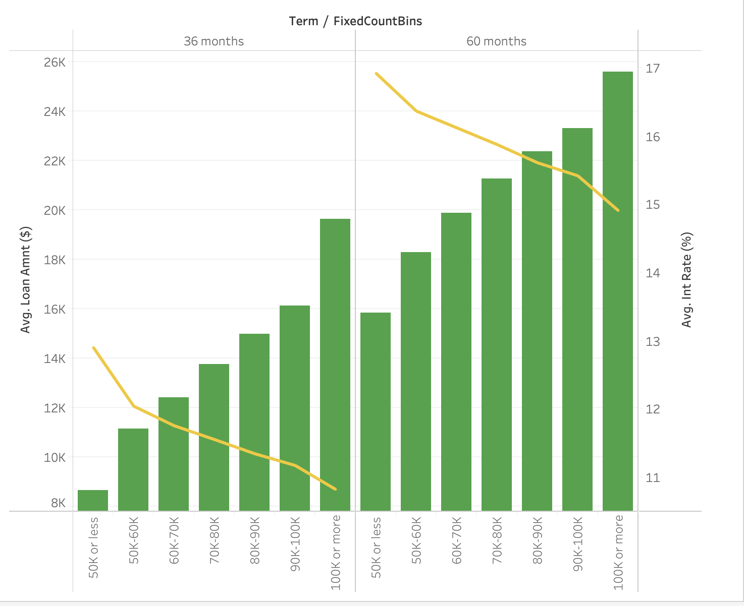
Loan Breakdown
2 fixed loan terms (36 or 60 months)
Avg Loan amount (binned bars)
Avg Interest Rate (line)
Short and smaller loan = higher IR
Long and large loan = smaller IR

